Slide 1

Heart Disease prediction
by Jitendra singh kushwah

Slide 2

Table of Contents
Introduction
Dataset Overview
Data Exploration (EDA) & Visualization
Data Processing
Preprocessing Pipeline Setup
Test-train split and model training
Model evaluation
Model COMPARISON & TAKEAWAYS
Final visualization and conclusion

Slide 3

Introduction
Heart disease is one of the leading causes of death worldwide. Early detection plays a vital role in preventing life-threatening outcomes. With the increasing availability of medical data, machine learning (ML) techniques can be leveraged to assist in accurate and early diagnosis of heart disease.
In this project, we explore and compare various machine learning models and a neural network to classify patients as either having heart disease or not based on clinical attributes. We apply preprocessing, perform hyperparameter tuning, and evaluate models using multiple metrics to determine the most effective approach.

Slide 4
Dataset overview
Source: Cleaned dataset derived from UCI Heart Disease dataset.
Target Variable: num (Binarized: 0 = no disease, 1 = disease)
Features:
Numerical: age, trestbps, chol, thalach, oldpeak, ca
Categorical: sex, cp, fbs, restecg, exang, slope, thal
Missing Values: Handled using SimpleImputer.
age sex cp trestbps chol fbs restecg thalach exang oldpeak slope ca thal num
298 45.0 1.0 1.0 110.0 264.0 0.0 0.0 132.0 0.0 1.2 2.0 0.0 7.0 1
299 68.0 1.0 4.0 144.0 193.0 1.0 0.0 141.0 0.0 3.4 2.0 2.0 7.0 1
300 57.0 1.0 4.0 130.0 131.0 0.0 0.0 115.0 1.0 1.2 2.0 1.0 7.0 1

Slide 5
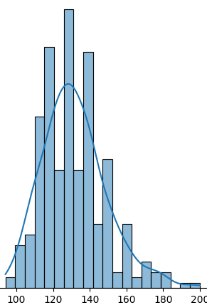
Data Exploration & Visualization
Why Visualization?
To understand the structure, distribution, and relationships in the dataset.
To detect class imbalances, outliers, missing patterns, and feature importance intuitively.
Plots Used & Why:
Histograms : To observe data spread, skewness, and potential outliers.
Countplots : To view the frequency distribution of categories and detect imbalance.
Pairplots : To visualize interactions and potential separability between feature pairs.
Correlation Heatmap : To quantify and visualize linear relationships between numerical features.
Bar Plot of Target Variable : To assess class balance and justify binary classification.

Slide 6
Data Processing
Processed data for training of model
Steps Taken:
Target Variable Binarization: Converted num from multi-class (0–4) to binary:
    0 → No disease
    1 → Disease present (1–4)
Missing Value Handling: ca and thal had missing values. Imputed using:
    Mean for numerical features
    Most frequent for categorical features
Feature Categorization: Separated columns into:
    Numerical → e.g., age, chol, oldpeak
    Categorical → e.g., sex, cp, thal

Slide 7
Preprocessing Pipeline Setup
Why a Pipeline?
To automate and standardize preprocessing steps
Avoid data leakage and ensure consistent transformations for training and testing
Pipeline Components:
Numerical Pipeline: SimpleImputer(strategy='mean’), StandardScaler()
Categorical Pipeline: SimpleImputer(strategy='most_frequent’),
OneHotEncoder(handle_unknown='ignore')
ColumnTransformer: Merged numerical and categorical pipelines . Applied transformations only to relevant columns
Result: Clean, scalable, and reusable preprocessing setup, Ready-to-use for model training

Slide 8
Test-train split and model training
Used train_test_split (80% train / 20% test)
Applied stratification to maintain class balance
Ensured that preprocessing was fitted only on training data (to avoid data leakage)
Used GridSearchCV with 5-fold cross-validation to find best hyperparameters
Models evaluated on test data using:
  Accuracy, Precision, Recall, F1 Score, AUC-ROC
  Confusion Matrix & Classification Report
Trained and evaluated 5 traditional ML models and 1 Neural network:
  Logistic Regression
  K-Nearest Neighbors (KNN)
  Support Vector Machine (SVM)
  XGBoost
  LightGBM
  MLP

Slide 9
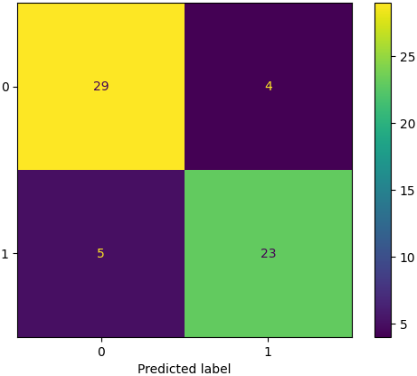
Model evaluation
Confusion Matrix:
Shows how predictions compare to actual labels
Helps identify:
  True Positives (TP): Correctly predicted disease cases
  True Negatives (TN): Correctly predicted non-disease cases
  False Positives (FP): Healthy predicted as sick
  False Negatives (FN): Sick predicted as healthy
Plotted for each model to visualize classification performance

Slide 10
EVALUATION METRICS
Accuracy | Overall prediction correctness
Precision | Proportion of predicted positives that are actually positive
Recall | Proportion of actual positives that are correctly identified
F1 Score | Harmonic mean of precision and recall
AUC-ROC | Measures odel’s ability to separate classes based on probability

Slide 11
Model COMPARISON & TAKEAWAYS
Top Performing Models:
SVM and KNN had the highest accuracy (88.5%) and strong recall, making them effective at identifying heart disease cases.
Logistic Regression and MLP (Neural Network) achieved high recall (92.8%) and best AUC-ROC (LogReg: 0.961), showing excellent class separation.
LightGBM had the highest precision (85.2%), making it the most cautious model in predicting positives.
General Insights:
All models achieved F1 Scores above 83%, indicating balanced performance.
Neural Network (MLP) was competitive with traditional models, despite no manual feature engineering.
Tree-based models (XGBoost, LightGBM) were solid but slightly behind in accuracy compared to simpler models.

Slide 12
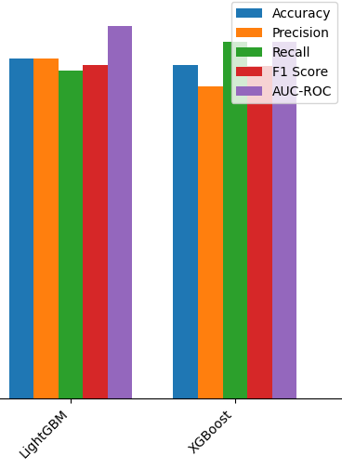
Final visualization and conclusion
Simpler models (e.g., Logistic Regression, SVM) can perform surprisingly well with proper preprocessing and tuning.
Deep learning is promising but not always necessary for structured/tabular data.
Final visualization was done by using bar chart

Slide 13

THANK YOU

